Slide 1
Distributed GraphLab
A Framework for Machine Learning and Data Mining in the Cloud
Ayushi Sinha

Slide 2
Distributed GraphLab Design
The Distributed Data Graph
Distributed GraphLab Engines
Chromatic Engine
Distributed Locking Engine
Fault Tolerance
System Design

Slide 3
Distributed GraphLab Design
The Distributed Data Graph
Distributed GraphLab Engines
Chromatic Engine
Distributed Locking Engine
Fault Tolerance
System Design

Slide 4
The Distributed Data Graph
Want
Balance between computation, communication, and storage
Notes:
What do we want? We want to maximize computation, while at the same time minimizing communication and storage.

Slide 5
The Distributed Data Graph
Want
Balance between computation, communication, and storage
Solution
Balanced partitioning of data graph minimizing number of edges between machines

Slide 6
The Distributed Data Graph
Implementation
Partition data graph into k parts, or atoms
Notes:
k > # machines

Slide 7
The Distributed Data Graph
Implementation
Partition data graph into k parts, or atoms
Each atom stored as a separate file
Each atom file is a simple compressed journal
Notes:
Each atom is stored as a separate file on a distributed storage system, for instance, HDFS or Amazon S3
Each atom file is a simple compressed journal of graph generating commands, for instance, AddVertex( 5000 , vdata ) or AddEdge( 42 -> 314 , edata )

Slide 8
The Distributed Data Graph
Implementation
Partition data graph into k parts, or atoms
Each atom stores the vertices and edges adjacent to the partition boundary, or ghosts
Notes:
Ghosts – the set of vertices and edges adjacent to the partition boundary

Slide 9
The Distributed Data Graph
Implementation
Partition data graph into k parts, or atoms
Each atom stores the vertices and edges adjacent to the partition boundary, or ghosts
Connectivity structure and file locations of the k atoms is stored in an atom index file

Slide 10
The Distributed Data Graph
Implementation
Partition data graph into k parts, or atoms
Each atom stores the vertices and edges adjacent to the partition boundary, or ghosts
Connectivity structure and file locations of the k atoms is stored in an atom index file
Obtain a meta-graph with k vertices and edges encoding the connectivity of atoms
Notes:
The k vertices of the meta-graph correspond to the k atoms

Slide 11
The Distributed Data Graph
Implementation
Partition data graph into k parts, or atoms
Each atom stores the vertices and edges adjacent to the partition boundary, or ghosts
Connectivity structure and file locations of the k atoms is stored in an atom index file
Obtain a meta-graph with k vertices and edges encoding the connectivity of atoms
Fast balanced partition of meta-graph achieves distributed loading
Notes:
Partition over # physical machines

Slide 12
The Distributed Data Graph
Implementation
Partition data graph into k parts, or atoms
Each atom stores the vertices and edges adjacent to the partition boundary, or ghosts
Connectivity structure and file locations of the k atoms is stored in an atom index file
Obtain a meta-graph with k vertices and edges encoding the connectivity of atoms
Fast balanced partition of meta-graph achieves distributed loading
Each machines constructs its local portion of the graph
Notes:
By playing back the journal from each assigned atom. The playback also instantiates the ghosts of the local partition in memory, creating caches for their true counterparts elsewhere on the network. They use a simple versioning system for cache coherence in order to eliminate transmission of unchanged or constant data (edge weights).
This two step partitioning scheme allows the same initial partition to be used for different number of machines without requiring a full repartitioning.

Slide 13
Distributed GraphLab Design
The Distributed Data Graph
Distributed GraphLab Engines
Chromatic Engine
Distributed Locking Engine
Fault Tolerance
System Design

Slide 14
Distributed GraphLab Engines
Execution model
Notes:
Distributed GraphLab engine emulates the execution model – executes update functions and sync operations, maintaining the set of scheduled vertices τ, ensuring serializability, etc.

Slide 15
Distributed GraphLab Engines
Execution model
The precise order in which vertices are removed from τ affects performance and expressiveness
Notes:
τ = set of scheduled vertices

Slide 16
Distributed GraphLab Engines
Execution model
The precise order in which vertices are removed from τ affects performance and expressiveness
Partial asynchronous execution → Chromatic Engine
Fully asynchronous, supporting vertex priorities → Locking Engine
Notes:
Chromatic Engine – low overhead
Locking engine – more expressive

Slide 17
Distributed GraphLab Design
The Distributed Data Graph
Distributed GraphLab Engines
Chromatic Engine
Distributed Locking Engine
Fault Tolerance
System Design

Slide 18
Chromatic Engine
Vertex coloring
Notes:
Applies a color to each vertex such that no adjacent vertices share the same color.

Slide 19
Chromatic Engine
Vertex coloring
Edge consistency model
Notes:
Given such a vertex coloring, the edge consistency model can easily be satisfied by synchronously executing all the vertices of the same color in the set τ before proceeding to the next color.
Sync between color-steps, where a color-step is the process of updating all the vertices within a single color and communicating the changes (analogous to super-step in the BSP model)

Slide 20
Chromatic Engine
Vertex coloring
Edge consistency model
Second-order vertex coloring
Notes:
No vertex shares the same color as any of its distance two neighbors

Slide 21
Chromatic Engine
Vertex coloring
Edge consistency model
Second-order vertex coloring
Full consistency model

Slide 22
Chromatic Engine
Vertex coloring
Edge consistency model
Second-order vertex coloring
Full consistency model
Assign all vertices the same color

Slide 23
Chromatic Engine
Vertex coloring
Edge consistency model
Second-order vertex coloring
Full consistency model
Assign all vertices the same color
Vertex consistency model

Slide 24
Chromatic Engine
Advantages
Efficient use of both network bandwidth and processor time within each color-step
Disadvantages
Requires a full communication barrier between color-steps
Presupposes the availability of graph coloring
Notes:
Adv – Chromatic engine operates in synchronous color-steps, changes to ghost vertices and edges are communicated asynchronously as they are made.
Disadv – All modifications much be communicated before proceeding to the next color
– Optimal vertex coloring is NP-hard. Although, reasonable graph colorings CAN be achieved. Many MLDM problems come with trivial colorings – for instance, many optimization problems produce bipartite (two-colorable) graphs, and problems based on templates can be colored using these templates.

Slide 25
Distributed GraphLab Design
The Distributed Data Graph
Distributed GraphLab Engines
Chromatic Engine
Distributed Locking Engine
Fault Tolerance
System Design

Slide 26
Distributed Locking Engine
Mutual Exclusion

Slide 27
Distributed Locking Engine
Mutual Exclusion
Readers-writer lock associated with each vertex

Slide 28
Distributed Locking Engine
Mutual Exclusion
Readers-writer lock associated with each vertex
Write-lock on central vertex
Notes:
Central vertex of each requested scope

Slide 29
Distributed Locking Engine
Mutual Exclusion
Readers-writer lock associated with each vertex
Write-lock on central vertex
Vertex consistency model

Slide 30
Distributed Locking Engine
Mutual Exclusion
Readers-writer lock associated with each vertex
Write-lock on central vertex
Vertex consistency model
Write-lock on central vertex, read-lock on adjacent vertices

Slide 31
Distributed Locking Engine
Mutual Exclusion
Readers-writer lock associated with each vertex
Write-lock on central vertex
Vertex consistency model
Write-lock on central vertex, read-lock on adjacent vertices
Edge consistency model

Slide 32
Distributed Locking Engine
Mutual Exclusion
Readers-writer lock associated with each vertex
Write-lock on central vertex
Vertex consistency model
Write-lock on central vertex, read-lock on adjacent vertices
Edge consistency model
Write-lock on central vertex and adjacent vertices

Slide 33
Distributed Locking Engine
Mutual Exclusion
Readers-writer lock associated with each vertex
Write-lock on central vertex
Vertex consistency model
Write-lock on central vertex, read-lock on adjacent vertices
Edge consistency model
Write-lock on central vertex and adjacent vertices
Full consistency model

Slide 34
Distributed Locking Engine
Mutual Exclusion
Readers-writer lock associated with each vertex
Write-lock on central vertex
Vertex consistency model
Write-lock on central vertex, read-lock on adjacent vertices
Edge consistency model
Write-lock on central vertex and adjacent vertices
Full consistency model
Deadlocks are avoided by acquiring locks sequentially following a canonical order
Notes:
Ordering is induced by machine ID followed by vertex ID since this allows all locks on a remote machine to be requested in a single message
Since the graph is partitioned, updates are restricted to each machine’s local vertices. Ghost vertices and edges ensure that updates have direct memory access to all information in the scope.

Slide 35
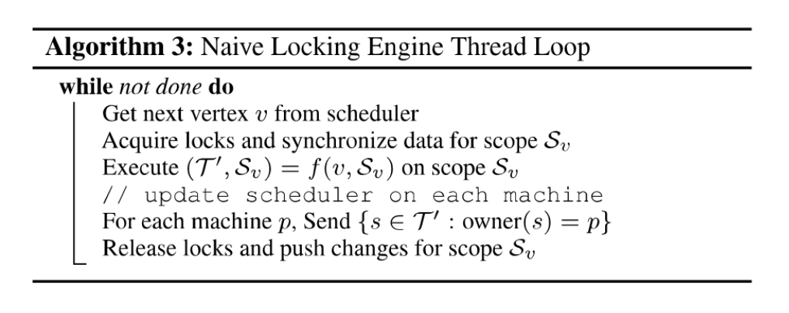
Distributed Locking Engine
Notes:
Each worker thread evaluated this loop

Slide 36
Distributed Locking Engine
Disadvantages
Latency of remote lock acquisition
Latency of data synchronization
Notes:
A naïve implementation, performs poorly

Slide 37
Distributed Locking Engine
Disadvantages
Latency of remote lock acquisition
Latency of data synchronization
Possible solutions
Ghosts provide caching capabilities
Pipeline lock requests and synchronization
Notes:
Caching capabilities eliminate the need to transmit or wait on data that has not changed remotely
Pipelined lock requests and synchronization calls allow each machine to request locks and data for many scopes simultaneously and then evaluate the update function only when the scope is ready

Slide 38
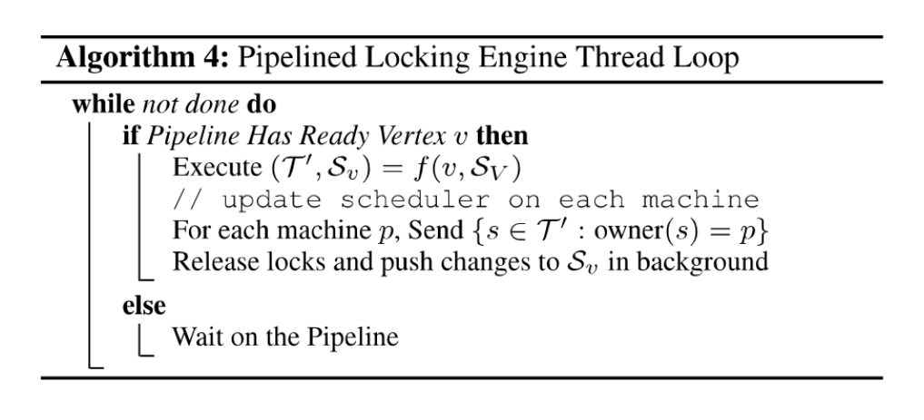
Distributed Locking Engine
Notes:
Pipelined lock and prefetching:
Each machine maintains a pipeline of vertices for which locks have been requested, but not fulfilled
Vertices that complete lock acquisition and data synchronization then leave the pipeline and are executed by worker threads
But, we don’t want to use regular reader-writer lock

Slide 39
Distributed Locking Engine
Non-blocking readers-writer lock
Notes:
Regular readers-writer lock would halt the pipeline on contention
So they implemented a non-blocking variation of this lock

Slide 40
Distributed Locking Engine
Non-blocking readers-writer lock
Operates through callbacks
Notes:
Lock acquisition request provides a pointer to a callback, which is called once the request is fulfilled. These callbacks are chained into a distributed continuation passing scheme that passes lock request across machines in sequence.

Slide 41
Distributed Locking Engine
Non-blocking readers-writer lock
Operates through callbacks
Deadlock free
Notes:
Lock acquisition follows the same canonical ordering as earlier, avoiding deadlocks

Slide 42
Distributed Locking Engine
Non-blocking readers-writer lock
Operates through callbacks
Deadlock free
Synchronization after each machine completes its local locks
Notes:
Synchronization of locked data after each local lock – reduces latency

Slide 43
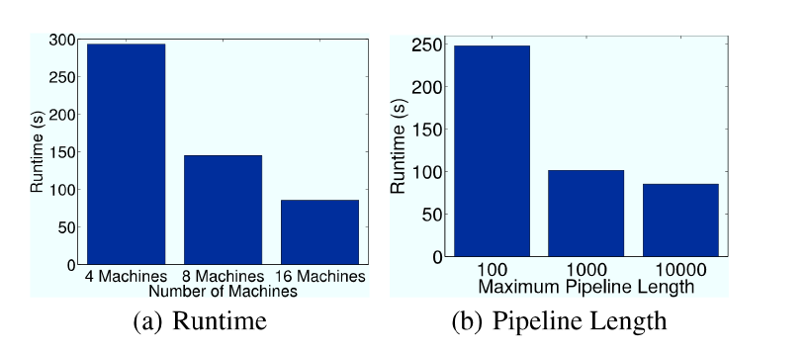
Distributed Locking Engine
Notes:
Evaluation on 3D mesh of 300x300x300 = 27,000,000 vertices
26 connected -> 375 million edges
512 atoms
Conclusions
--------------
Distributed locking provides linear scalability
Increasing pipeline length from 100 to 1000 leads to 3x reduction in runtime

Slide 44
Distributed GraphLab Design
The Distributed Data Graph
Distributed GraphLab Engines
Chromatic Engine
Distributed Locking Engine
Fault Tolerance
System Design

Slide 45
Fault Tolerance
Distributed checkpoint

Slide 46
Fault Tolerance
Distributed checkpoint
Synchronous method
Notes:
Suspends all computation (including update functions, flushing all communication channels) while the snapshot is constructed (saving all modified data).
But we’re trying to avoid the inefficiencies of synchronous computation

Slide 47
Fault Tolerance
Distributed checkpoint
Synchronous method
Asynchronous method
Notes:
Incrementally constructs a snapshot without suspending execution

Slide 48
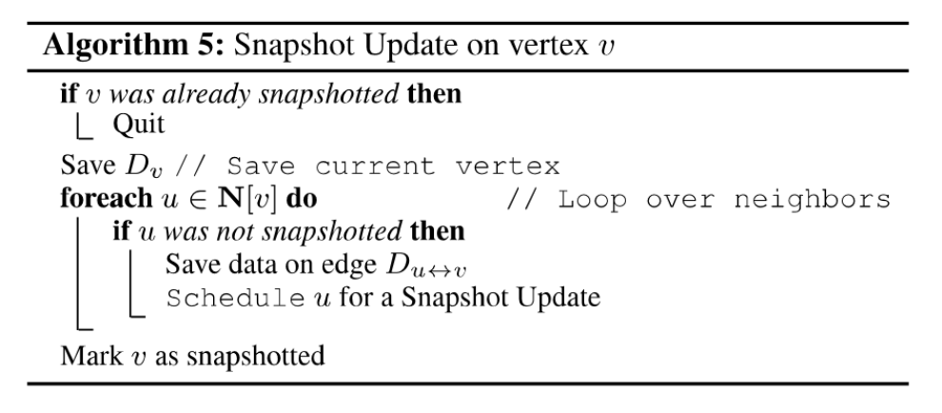
Fault Tolerance

Slide 49
Fault Tolerance
Distributed checkpoint
Synchronous method
Asynchronous method
Edge consistency is used on all update functions
Schedule completes before scope is unlocked
Snapshot update is prioritized over other update functions
Notes:
Guarantees a consistent snapshot given the above conditions
These are satisfied with minimal changed to GraphLab

Slide 50
Fault Tolerance
Distributed checkpoint
Synchronous method
Asynchronous method
Edge consistency is used on all update functions
Schedule completes before scope is unlocked
Snapshot update is prioritized over other update functions
Snapshot interval

Slide 51
Fault Tolerance
Distributed checkpoint
Synchronous method
Asynchronous method
Edge consistency is used on all update functions
Schedule completes before scope is unlocked
Snapshot update is prioritized over other update functions
Snapshot interval
Balance cost of constructing checkpoint vs. computation lost since last checkpoint
Notes:
… In case of failure

Slide 52

Fault Tolerance
Distributed checkpoint
Synchronous method
Asynchronous method
Edge consistency is used on all update functions
Schedule completes before scope is unlocked
Snapshot update is prioritized over other update functions
Snapshot interval
Balance cost of constructing checkpoint vs. computation lost since last checkpoint
Notes:
T_checkpoint = time to complete checkpoint
T_MTBF = time between failures for the cluster

Slide 53
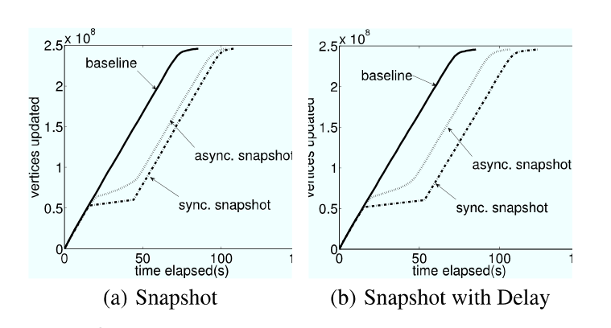
Fault Tolerance
Notes:
Same synthetic mesh as before
Running on 16 machines (128 processors)
One snapshot in the middle of the second iteration

Slide 54
Distributed GraphLab Design
The Distributed Data Graph
Distributed GraphLab Engines
Chromatic Engine
Distributed Locking Engine
Fault Tolerance
System Design

Slide 55
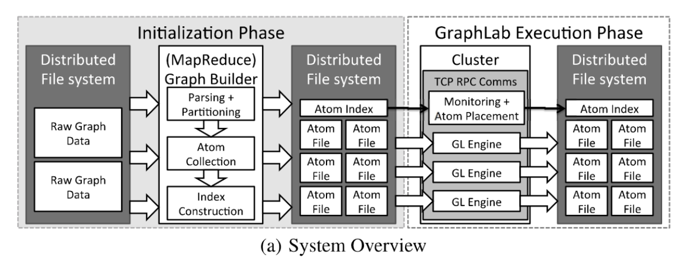
System Design
Notes:
Begins by constructing atom graph representation on a Distributed File System (DFS) – if hashed partitioning is used the processes is map-reduceable, where map is performed over each vertex and edge, and each reducer accumulates an atom file.
In the execution phase, atom files are assigned to individual execution engines.

Slide 56
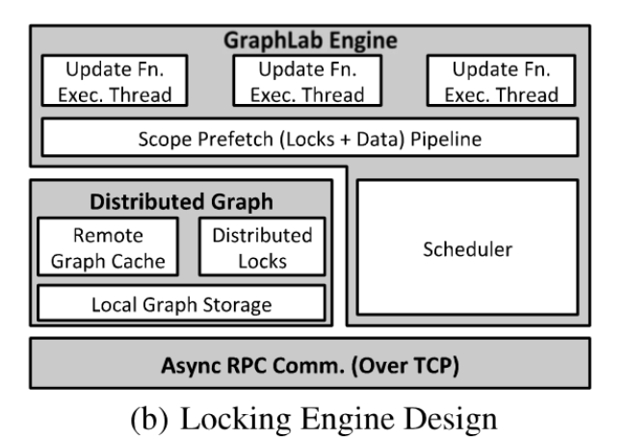
System Design
Notes:
When GraphLab is launched, a master process (the first process) computes the placement of atoms on machines based on atom index. All processes perform a parallel loading of the atoms assigned. Each machine runs one instance of GraphLab. The different processes communicate using a custom asynchronous protocol over TCP/IP.
Each process is responsible for a partition of the distributed graph, stored in a local graph storage, and provides distributed locks. A cache stores the ghost vertices and edges.
Each process also contains a scheduler that manages the vertices in τ that have been assigned to the process.
At runtime, each machine’s local schedule feeds vertices into a prefetch pipeline, which collects the data and locks required for the execution, which is performed by a pool of worker threads.
----------------------
Vertex scheduling is decentralized – each machine managing the schedule for its local vertices, requesting scheduling for remote vertices.

Slide 57
Applications
Netflix Movie Recommendation
Video Co-segmentation
Notes:
Netflix – chromatic engine
Co-seg – distributed lock engine

Slide 58
NetfLIX Movie Recommendation
Uses collaborative filtering, computed with alternating least squares
Notes:
To compute movie recommendations
The algorithm iteratively computes a low-rank matrix factorization

Slide 59
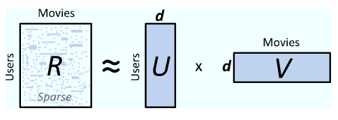
NetfLIX Movie Recommendation
Uses collaborative filtering, computed with alternating least squares
Notes:
R contains movie ratings for each user
U contains the users – rank d
V contains movies – rank d… Higher d increases both accuracy and computational cost
The algorithm alternates between computing the least-squares solution for U and V while holding the other fixed.
This might not seem like a graph algorithm, but it can be represented elegantly using GraphLab.

Slide 60
NetfLIX Movie Recommendation
Uses collaborative filtering, computed with alternating least squares
Bipartite Graph
Notes:
R is two colorable → edge consistency model can be used → chromatic engine
GraphLab update function recomputes the d length vector for each vertex by reading the d length vectors on adjacent vertices and solving a least-squares regression problem to predict the edge values.

Slide 61
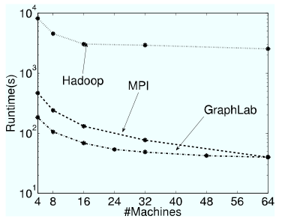
NetfLIX Movie Recommendation

Slide 62
Video Co-segmentation
Identifies and clusters spatio-temporal segments of videos
Notes:
That share similar texture and color
Processes all frame simultaneously, models temporal stability

Slide 63
Video Co-segmentation
Identifies and clusters spatio-temporal segments of videos
Predicts best label using Gaussian Mixture Model (GMM) and Loopy Belief Propagation (LBP)

Slide 64
Video Co-segmentation
Identifies and clusters spatio-temporal segments of videos
Predicts best label using Gaussian Mixture Model (GMM) and Loopy Belief Propagation (LBP)
GMM and LBP are combined to form an Expectation-Maximization problem
Notes:
GMM estimates best label based on color and texture
Neighboring pixels are connected in time and space into a 3D grid, and LBP smoothes local estimates provided by GMM
EM problem is solved by alternating between LBP, which computes the label given the GMM, and updating GMM given labels from LBP
----------------
GraphLab update function executes LBP iterative update
Updates that are expected to change vertex values significantly are prioritized → Distributed locking engine with priority scheduler
GMM parameters are maintained using sync operation

Slide 65
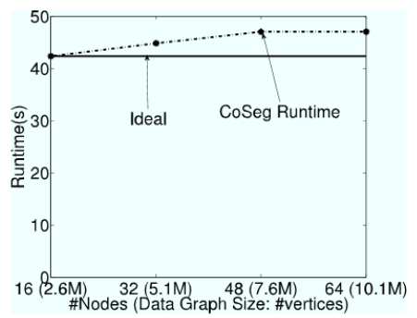
Video Co-segmentation
Notes:
10.5 million vertex graph
10x speedup with 16x more machines
Nearly optimal weak scaling – runtime doesn’t increase significantly as the size of the graph increases – due to good graph partition, # edges crossing machines increases linearly with # machines → low communication

